Slide 1

Weekly Report
Tianyu Wang
August 11,2021

Slide 2
Review of Last Meeting
Completed:
1. Data cleaning of commit message and pull request.
2. Collection of pull request message related to the natural language.
To do:
Do the data cleaning from the view of mark down language.
Collect code comment several lines before the starting line and do the data cleaning.
Collect message except natural language in pull request.

Slide 3

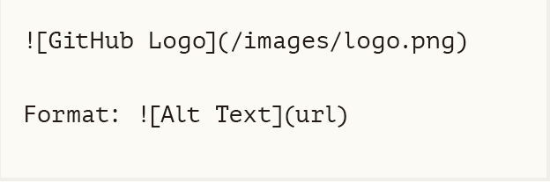
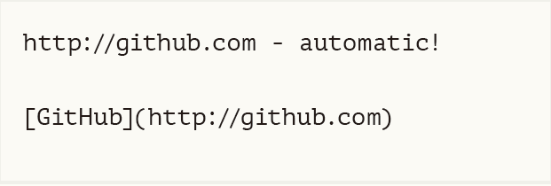
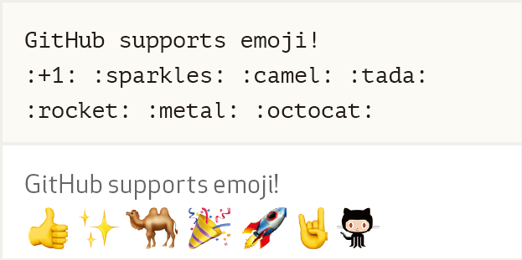
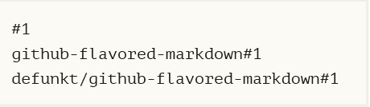
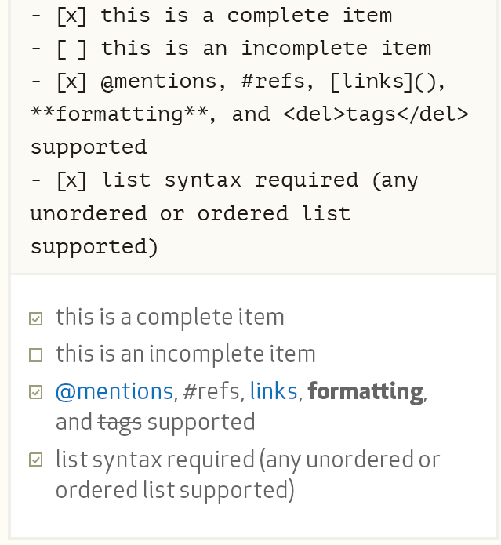
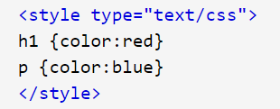
Data cleaning of markdown language
Images
"(!(\[([^\[\]]*?)\])\([^\[\]]*?\))"
Links
"((\[([^\[\]]*?)\])\([^\[\]]*?\))"
Emoji
Issue references
"#\d+"
Html tags
Taks lists
"(?:- \[x\]|- \[ \])"

Slide 4
Identify file path
“/” can means “slash” or “or”
Examples : nd4j-backends/nd4j-api-parent; number/order; ingestion/persist/merge/query
Using enchant package to find out spelling mistakes.
No. can only occur in path.

Slide 5
Collection of code comment
Procedure
Get codes for 15 lines before the starting line.
Remove the blank lines.
Find out the last line with “;” or “;//xxxx” ending and discard all lines before it.
Observe the line closest to the starting line.
While(1)
{
print(“hello world”);//for test
print(“hello world”);
}
Starting line:
print(“hello world”);//for test
print(“hello world”);
{
Starting line:
print(“hello world”);//for test
print(“hello world”);
Starting line:
print(“hello world”);//for test
print(“hello world”);
Case 1:
Starting line:

Slide 6
See if there is “class” or “public” or “protect” or “private” in the code block
}
}
/*
*
*
*/
Public void test(){
Starting line:
}
/*
*
*
*/
Public void test(){
Starting line:

Slide 7
Observe the line closest to the starting line, if there is @ in it.
}
/**
* Expect no batching to occur and limit to be applied. Input is a sequence of sorted single-event ScanResultValues
* (unbatching and sorting occurs in ScanQueryRunnerFactory#mergeRunners()).
*/
@Test
Starting line:

Slide 8
Find the code block which starting line belongs to.
}
}
} else if (c == '}') {
// This end brace terminates a command. This can be the case in
// constructs like {\aa}. The correct behaviour should be to
// substitute the evaluated command and swallow the brace:
}
} else if (op.x() != null && op.z() != null) {
//double arg call
if (Nd4j.dataType() == DataBuffer.Type.FLOAT) {
loop.execRandomFloat(null, op.opNum(), rng.getStatePointer(), // rng state ptr
(FloatPointer) op.x().data().addressPointer(),

Slide 9
} catch (Exception ex) {
}
} // end finally
} // end encodeFileToFile
/**
* Reads <tt>infile</tt> and decodes it to <tt>outfile</tt>.
*
* @param infile Input file
* @param outfile Output file
* @throws java.io.IOException if there is an error
* @since 2.2
*/
{
} else {}
while (init < 10 ||
!flag) {
}
}
}
Inner anon = new Inner
(){ //warn

Slide 10
Data cleaning of code comment
@xxxx
{@xxx xxxx}
html tags
url
#include

Slide 11
/* Uncomment when Druid support for nulls/empty strings is actually consistent
List<Result<TopNResultValue>> expectedTopNResults = Arrays.asList(
new Result<TopNResultValue>(
new DateTime("2011-01-12T00:00:00.000Z"),
new TopNResultValue(
Arrays.<Map<String, Object>>asList(
ImmutableMap.<String, Object>builder()
.put("market", "total_market")
.put("rows", 2L)
.put("index", 200.0D)
.put("addRowsIndexConstant", 203.0D)
.put("uniques", UNIQUES_1)
.put("maxIndex", 100.0)
.put("minIndex", 100.0)
.build()
)
)
)
);
*/
// tf.setHeight(w + "px");
// tf.setIcon(new ThemeResource("icons/16/document-add.png"));

Slide 12
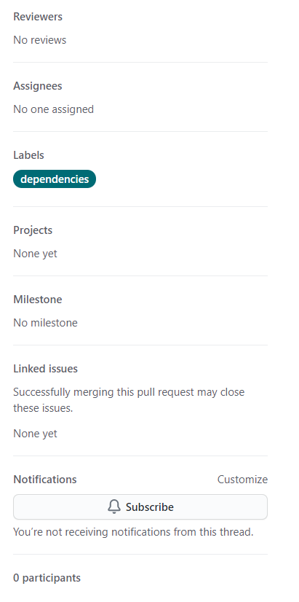
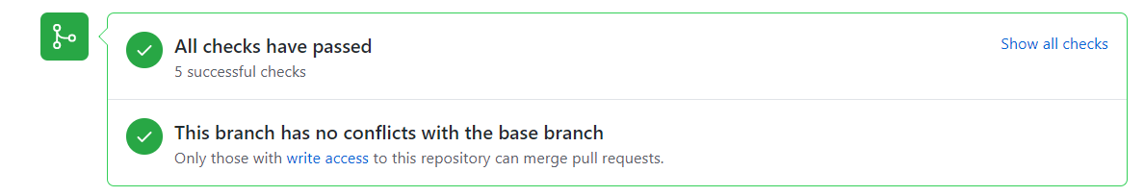
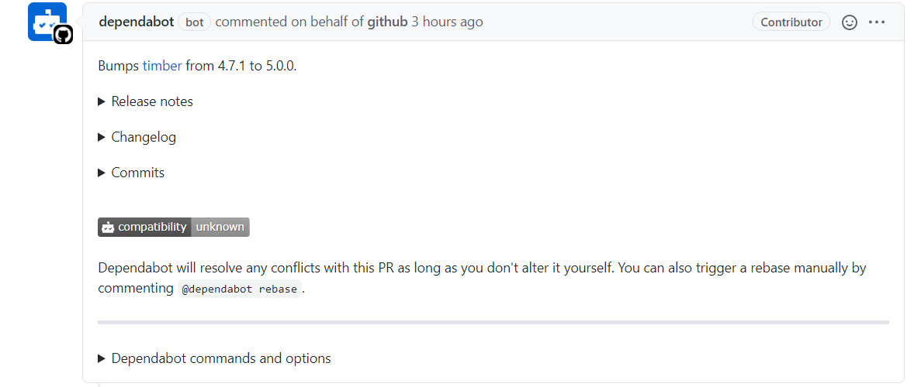
Collection of code comment

Slide 13
Next Step
1.Complete the collection of pull request.

